Slide 1
MAMBO Shrub identification Biomass estimation
Show and tell
15/05/2024

Slide 2
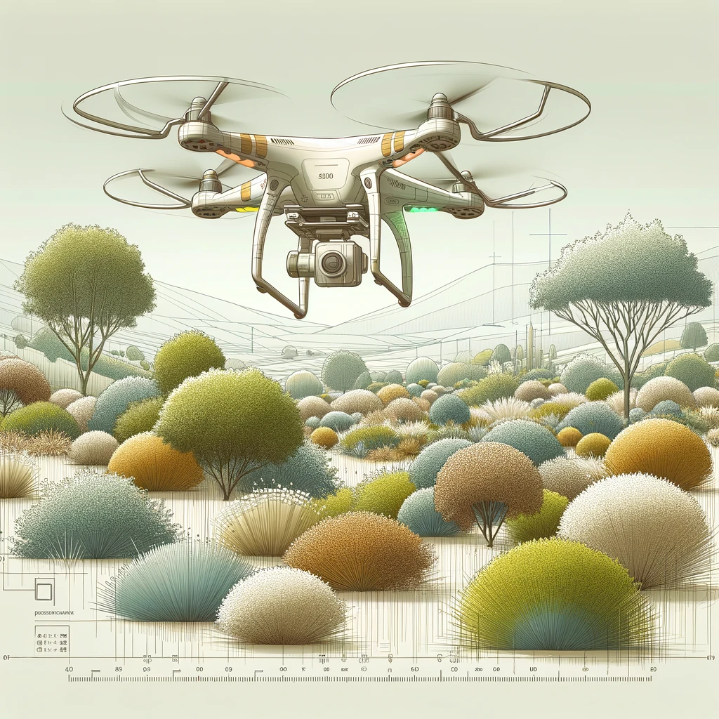
Main objectives
Segmentation of individual clumps of shrubs
Estimating shrub biomass
Identifying shrub species

Slide 3
Main objectives
Segmentation of individual clumps of shrubs
Estimating shrub biomass
Identifying shrub species

Slide 4
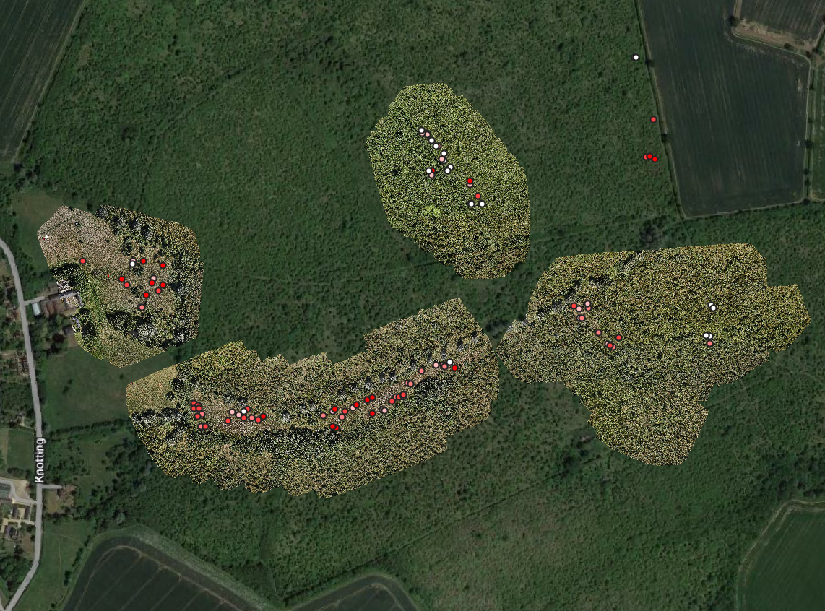
Area of study Strawberry Hills Farm
Reforesting since 1990s

Slide 5
Data collection
Field surveys
Individual shrubs (no clumps), species, height, diameter
Biomass
SfM
RGB, DSM
LiDAR
RGB-NIR, DSM-DTM

Slide 6
Data collection
Field surveys
Individual shrubs (no clumps), species, height, diameter
Biomass
SfM
RGB, DSM
LiDAR
RGB-NIR, DSM-DTM

Slide 7
Data manipulation
Identifying shrubs
R-CNN
Training points (manual identification)
Heights/biomass
Field points + LiDAR as “ground-truth”
SfM + EA 1m LiDAR as main goal

